Slide 1


Optimizing UltraScan Job Scheduling with Deep Learning-Based Performance Prediction
AARON L. HOUSEHOLDER University of Central Florida aaroncs@ucf.edu | CLIFF C. ZOU University of Central Florida changchun.zou@ucf.edu | EMRE H. BROOKES University of Montana emre.brookes@umontana.edu

Slide 2
Why Runtime Prediction Matters
Inaccurate estimates lead to resource waste
Overestimation blocks queues
underestimation causes failures
Better predictions improve HPC throughput

Slide 3
UltraScan in Scientific HPC
analysis tool for AUC experiments
14M+ jobs tracked since 2009
structural biology and biophysics

Slide 4
Why Two-Dimensional Spectrum Analysis (2DSA) Is Hard to Predict
Nonlinear interactions between parameters
Monte Carlo iterations
grid resolution
noise fitting
Wide variability in runtime

Slide 5
Existing Solutions and Their Limits
Heuristic and test-job methods used previously
Linear models not robust enough
Lacked accuracy for real production use

Slide 6
Project Goals
Build data-driven CPU time prediction models
Handle high-dimensional input parameters
Support future integration into LIMS and HPC schedulers

Slide 7
Our Data Collection Pipeline
Extracted job records from 75+ LIMS databases
Used PHP scripts + JSON config for flexible extraction
327,000+ complete records gathered
Combined job request, results, and XML config fields

Slide 8
Preprocessing and Outlier Handling
Removed constant and invalid fields from dataset
Encoded categorical values (e.g., cluster names)
Removed negative values and unreliable records
Z-score calculation used for outlier detection
For 2DSA reduced parameters from 86 to 22 columns

Slide 9
Full Model Training Workflow
Pipeline: extract → preprocess → train → evaluate
Multiple methods trained separately (2DSA, GA, PCSA)
Each model tagged with error stats for selection
Process designed to support future deployment

Slide 10
Hyperparameter Grid Search
Evaluated 432 configurations per method
Tuned layers, optimizers, batch size, activations, dropout
Used ELU and Adam for best performance in 2DSA
Used 70% training, 15% validation, 15% test split

Slide 11
Feature Analysis
Tested LASSO, Random Forest, and XGBoost
Top features: MC iterations, grid points, noise options
Monte Carlo settings most predictive of runtime
Feature selection alone didn’t improve performance

Slide 12
Model Performance: Accuracy and Error Distributions
93% of 2DSA jobs predicted within 5-minute error
Some jobs had extreme deviations (long-tail errors)
GA predictions less reliable due to job behavior
Model generalization good across most job types

Slide 13
Z-Score Buffering Strategy
Used Z-score to estimate parameter extremity
Added buffer based on max error by Z-score
Adaptively increases safety margin for runtime
Prevents underestimated job failures

Slide 14
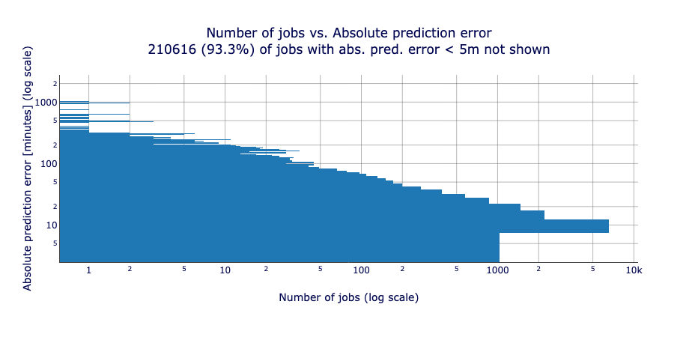
Visualizing the Long Tail
Shows log–log distribution of job prediction error
Most jobs have small errors; few extreme outliers
Reinforces need for adaptive error margins
Helps diagnose model weaknesses

Slide 15
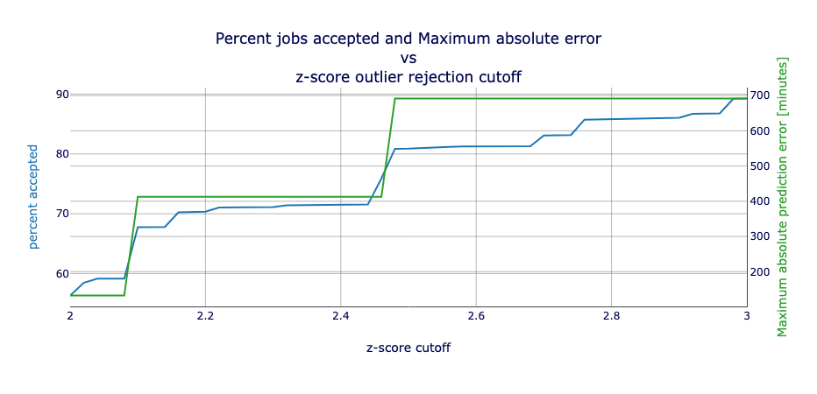
Z-Score vs Error Tradeoff (Figure 3)
Lower Z-score: lower error, fewer jobs accepted
Higher Z-score: higher error, more jobs accepted
Tradeoff curve supports runtime buffering strategy in production
Used to select optimal Z for each job

Slide 16
Best Model Selections
Method | Z-score 2 Max. Absolute Error (Acceptance) | Z-score 3 Max. Absolute Error (Acceptance) | Job Count | Model Architecture | Optimizer | Scaler
2DSA | 2h 13m (56%) | 11h 32m (89%) | 265,346 | 21-128-64-1 | Adam | Standard
GA | 6d 7h (70%) | 6d 7h (71%) | 14,006 | 25-128-64-1 | SGD | Robust
PCSA | 1h 57m (64%) | 5h 17m (90%) | 45,340 | 25-512-256-128-1 | Adam | Standard
Used minimum max error across all data as criterion
Based on validation and full-dataset performance

Slide 17
Real-World Impact
Improved runtime estimates → better queue utilization
Reduced overestimation and job failures
Supports fairer, more efficient HPC resource use
Builds trust in automated runtime prediction

Slide 18
Toward Production: Microservice Deployment
Designed prediction model for API integration
Planned microservice for UltraScan LIMS
Real-time prediction support for job submission
Memory (RSS) prediction is next target

Slide 19
Other Domains
Framework applies to other workloads with historical data
Parameter-based modeling works across HPC domains
Seeking to identify and test in other scientific software

Slide 20
Lessons Learned
With smaller parameter counts, feature selection methods
Z-score buffering helps mitigate prediction risk
GA prediction needs further refinement
Production-ready prediction requires robust pipelines

Slide 21
Acknowledgments
NIH (R01GM120600), NSF (DGE-2325452)
Jetstream2 (ACCESS MCB070038)
Canadian Center for Hydrodynamics
Thanks to collaborators and advisors

Slide 22
Key Takeaways
Deep learning improves HPC job runtime prediction accuracy
Z-score buffering enhances utility in production
Framework is generalizable — exploring new domains
Seeking applications with datasets to build models

